Slide 1




Enhancing Infrastructure Detection Using Drone Imagery: A Comparative Analysis Using Machine Learning Models with a Custom Bangladesh-Based Dataset for Improved Urban Planning
Thesis ID : T2320020
Shudeb Ghosh Barno | 20301222
Atikur Rahman | 20301440
Nabila Islam Borno | 20301117
Musaib Ibn Habib Mikdad | 20301356
Md. Rafiul Islam Mahi | 20301324
Supervisor
Dr. Md. Khalilur Rahman
Professor
Co-Supervisor
Mr. Rafeed Rahman
Lecturer
.
Brac University

Slide 2

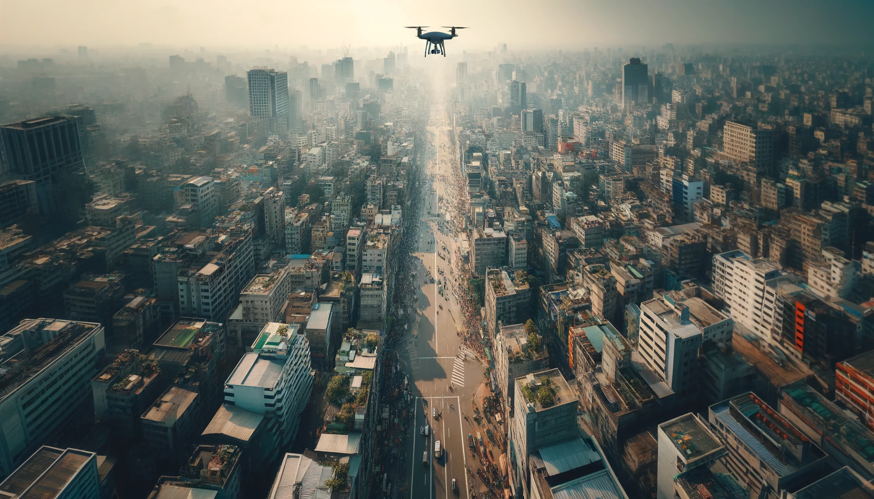
02
Abstract
Advanced machine learning models (YOLOv5, YOLOv7, YOLOv8, Custom model) for urban infrastructure detection using drone imagery in Bangladesh.
Evaluation of detection accuracy and speed across various urban conditions.
A unique dataset tailored for urban Bangladesh.
Scalable solutions for urban planning in densely populated cities to foster sustainable urban development.

Slide 3
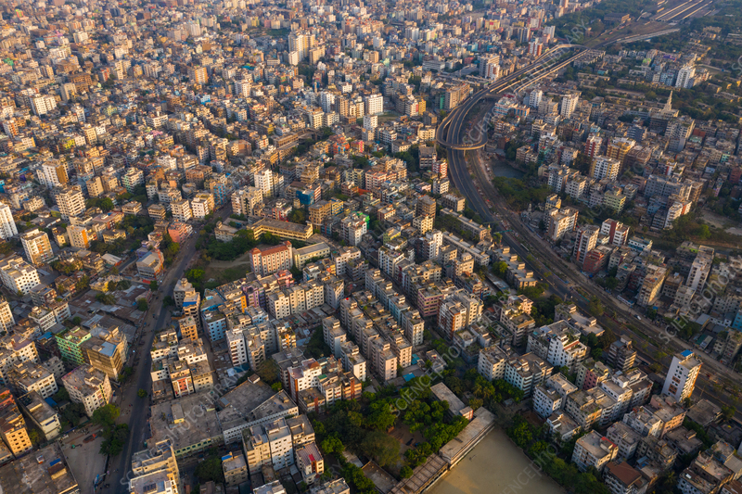
03
Overview
01
Introduction
06
Implementation
02
Research Objectives
07
Dataset
03
Research Problem
08
Result
04
Literature Review
09
Future Work
05
Working Plan
10
References

Slide 4

04
Introduction
Provides detailed views of city evolution
Analyzes images to extract urbanization patterns
Monitors changes to inform planning
Supports sustainable and resilient community development
Helps planners and policymakers with reliable data

Slide 5
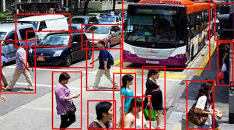
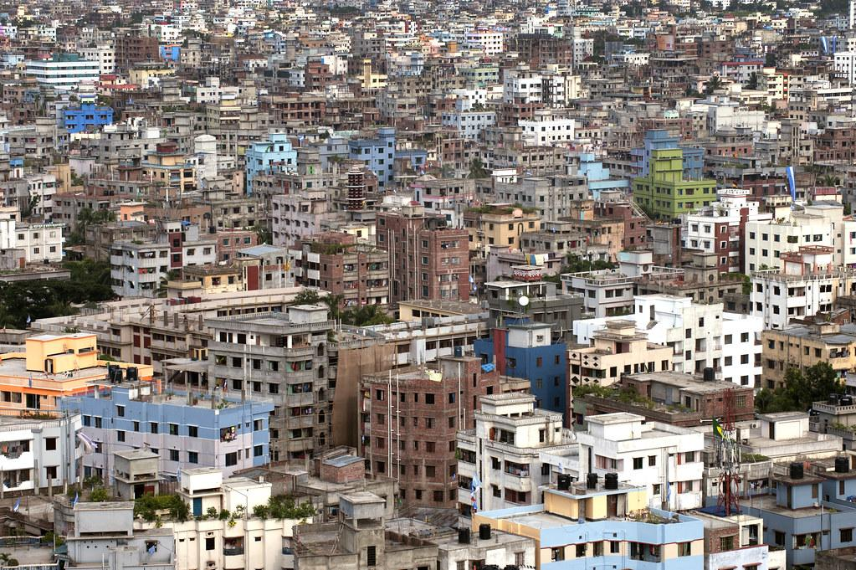

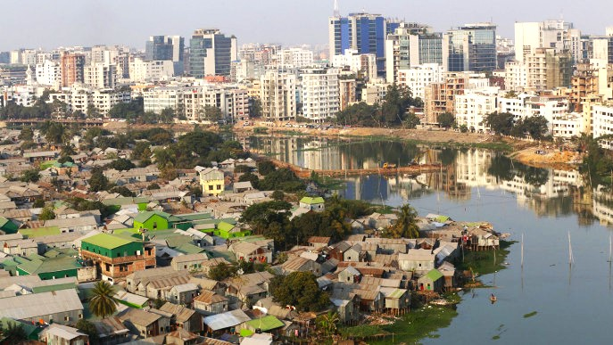



05
Objectives
Objective 2
Objective 3
Objective 4
Objective 1
Develop Predictive Model
Monitor Urban Expansion
Support Urban Planning Efforts
Analyze Socio-Economic Impacts

Slide 6





Research Problems
06
Traditional paperwork methods are inefficient and cumbersome for policymakers.
Lack of familiarity with digital approaches exacerbates the issue.
Labor Extensive
Costly
Time Extensive
Less Accuracy

Slide 7
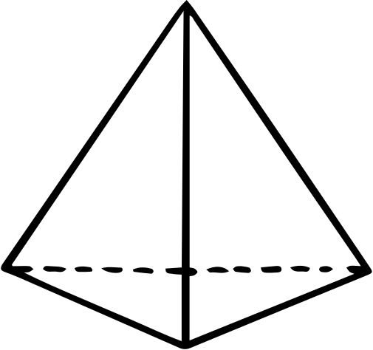

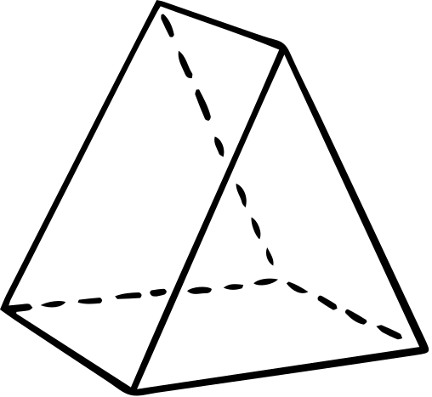
Literature Review
08
Bangladesh Bureau of Statistics (2023): Collaborated with the Prime Minister's Office and other key government departments to use satellite imagery and machine learning for estimating poverty. This approach aims to enhance the precision of poverty measurements, crucial for allocating resources effectively towards achieving Sustainable Development Goals (SDGs) and managing disasters. The use of geographically detailed data allows for more targeted policy implementation in a dynamic economic environment.

Slide 8
07
Huerta et al. (2021): Utilized convolutional neural networks (CNNs) with U-Net architecture and very high-resolution imagery to semantically segment urban green spaces, addressing challenges in fast-developing metropolitan areas.
01
Hu et al. (2023): Developed Efficient-Lightweight YOLO models with efficient spatial pyramid pooling and Alpha Intersection over Union techniques to improve small object detection, crucial for traffic monitoring and urban planning.
02
Literature Review
Xue et al. (2021): Proposed an unsupervised change detection method based on a Gaussian mixture model guided by saliency enhancement, improving the identification of temporal changes in urban landscapes.
03
Yadav et al. (2019): Explored the use of UAV-based remote sensing technology to regulate and track green ecosystems, demonstrating effective real-time detection and monitoring of various tree species in urban areas.
04

Slide 9
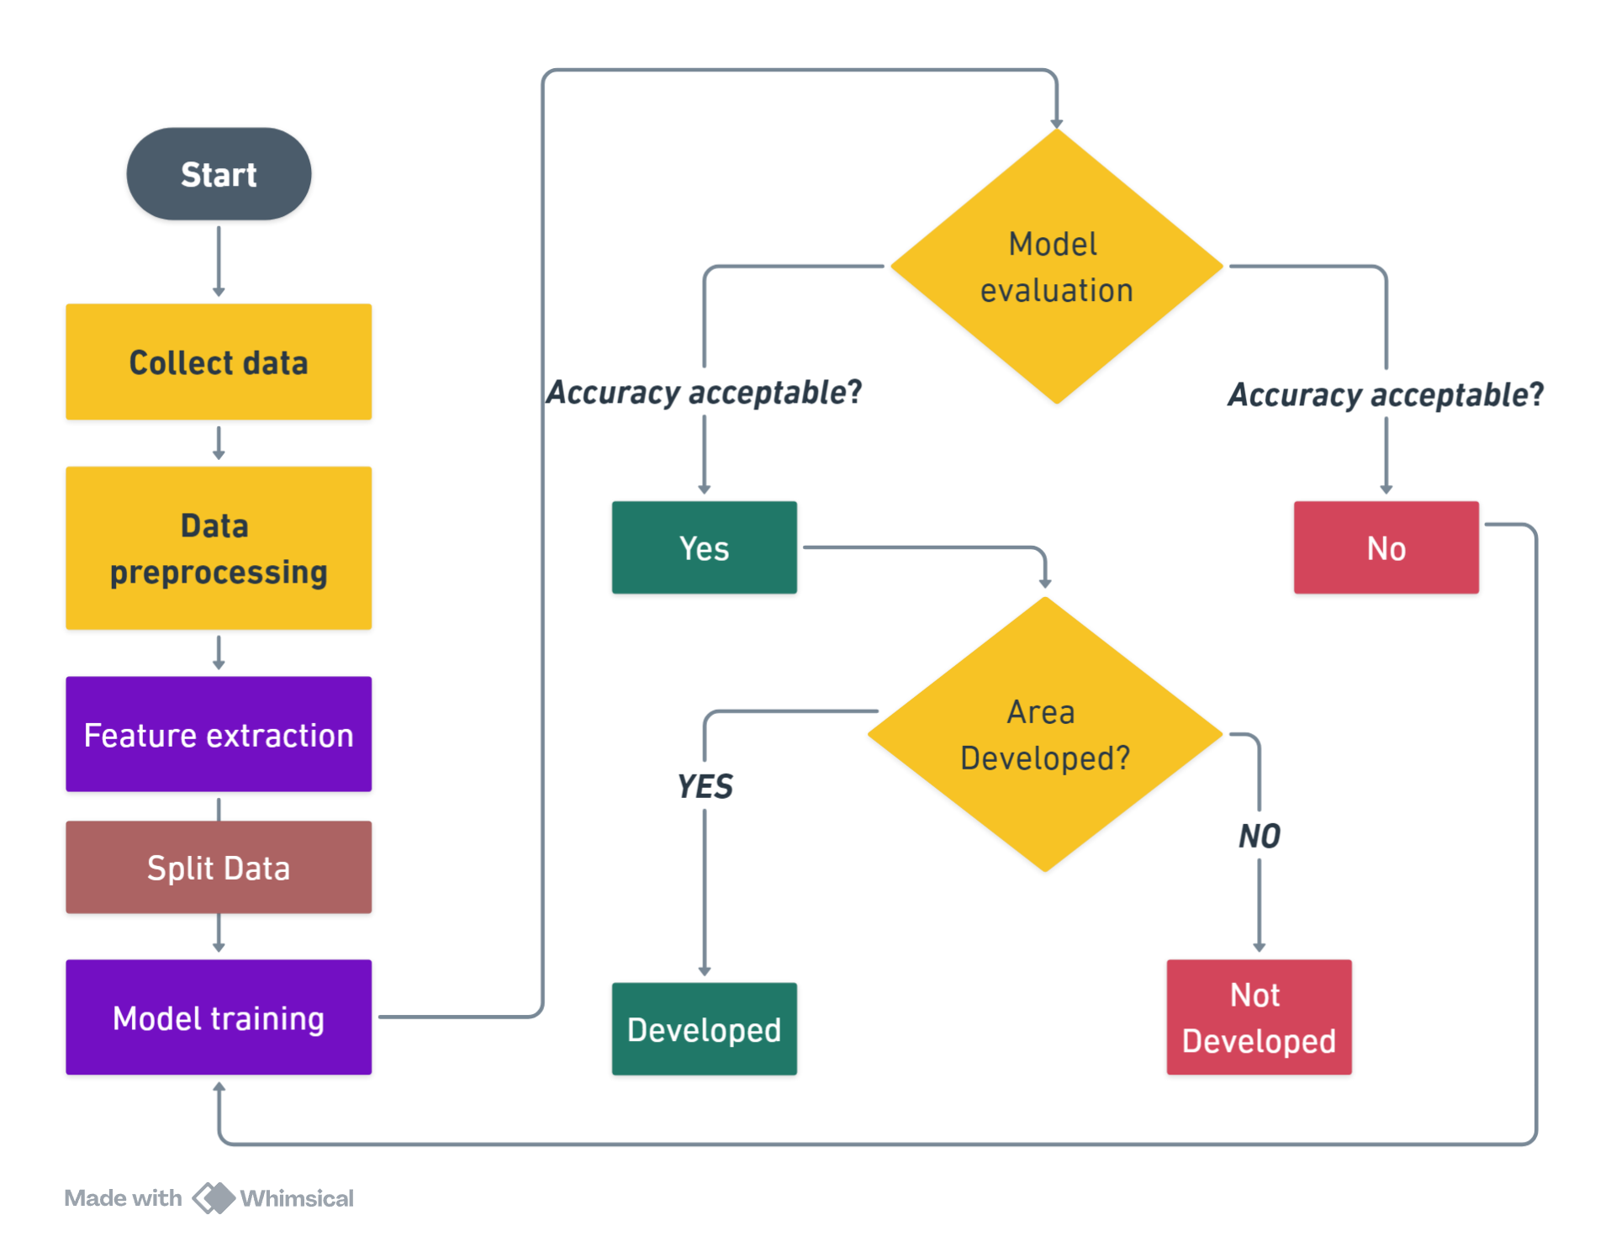
Working Plan
09
Overview
Data Acquisition
Image Preprocessing
Feature Extraction and Analysis
Visualization and Interpretation

Slide 10



10
Implementation
Evaluate the trained model on the test dataset.
Model Selection
02
04
01
03
05
Collect
And Preprocess
Data
Train the model using the training dataset.
Deploy the model to make predictions on new, unseen data.

Slide 11
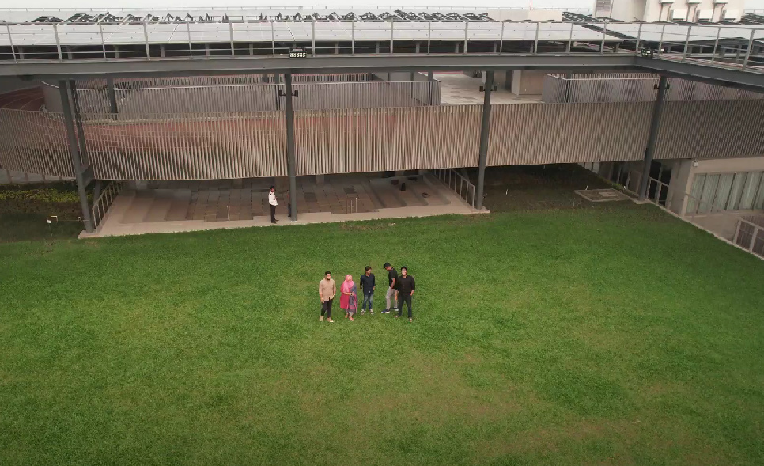
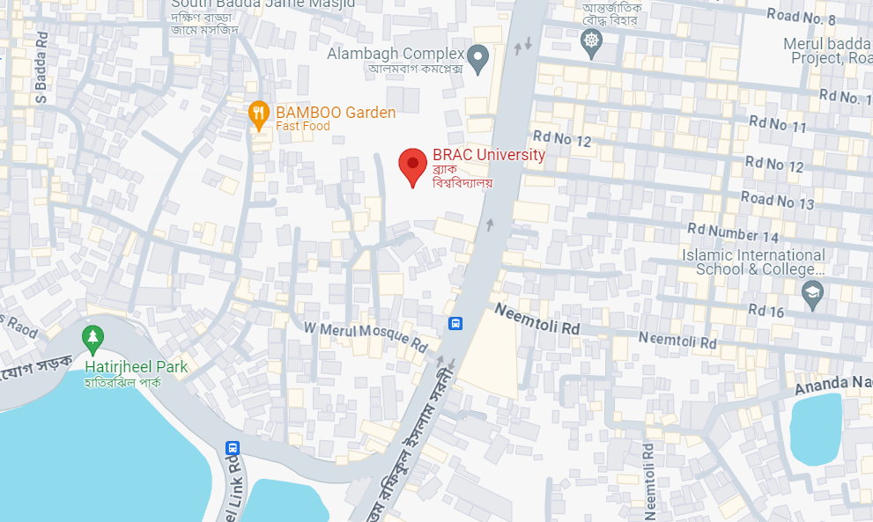
11
Dataset
Capture detailed aerial images of the Merul Badda sub-district in Dhaka, focusing on BRAC University's new campus development.
Identified positions and latitudes.
Regular image acquisition documenting construction and expansion.
Covered buildings, landscapes, roads, solar panels, etc.
Curated dataset showing current and evolving landscapes.

Slide 12
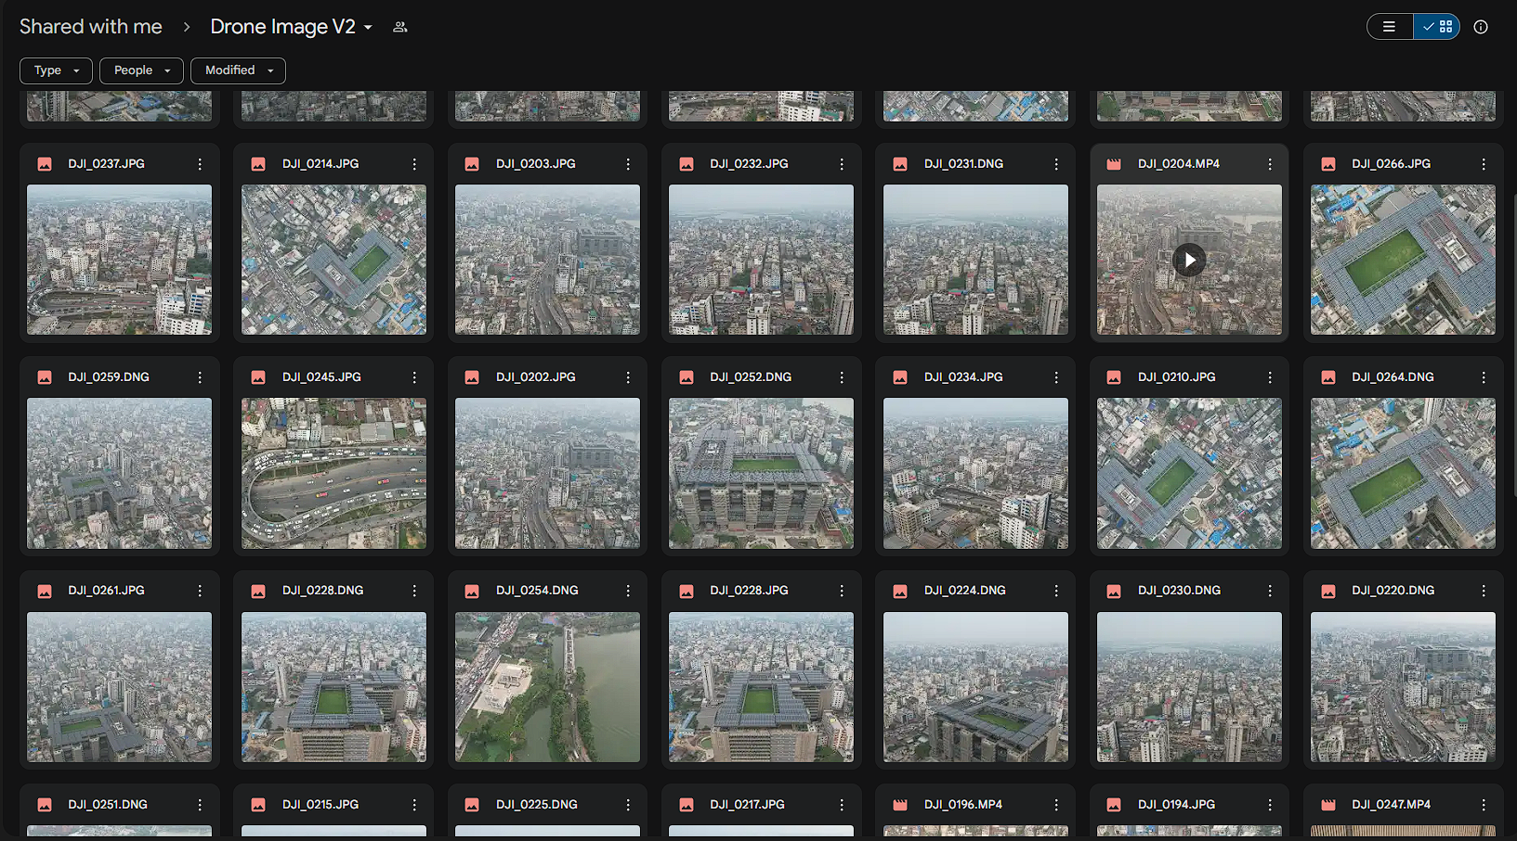
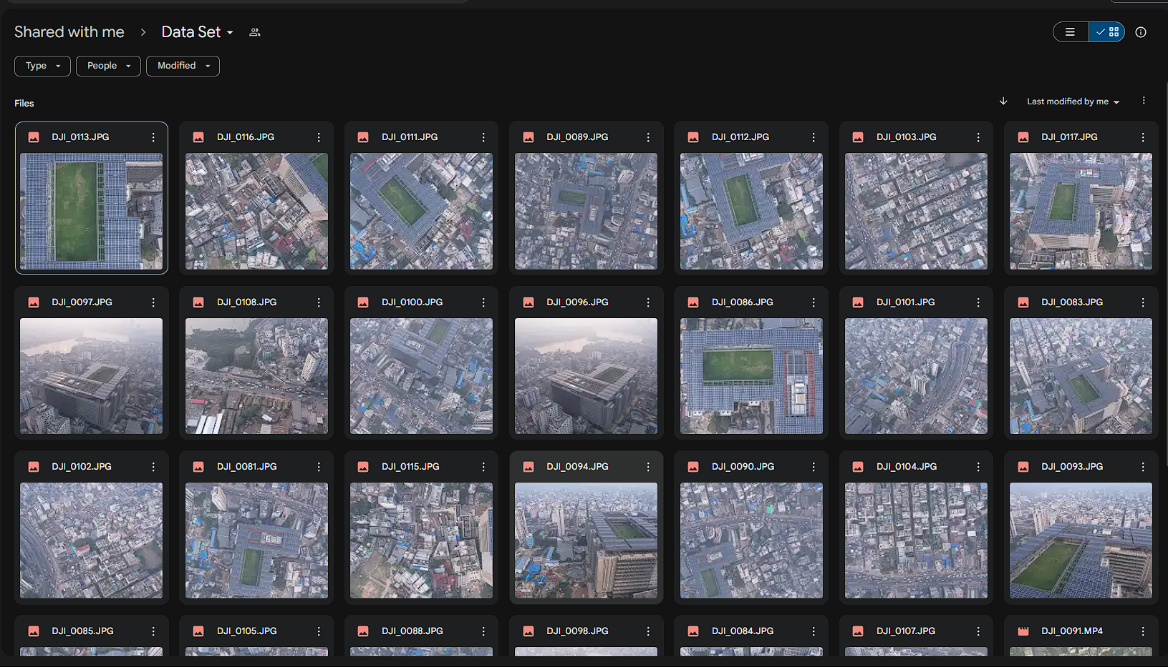
Dataset
12

Slide 13
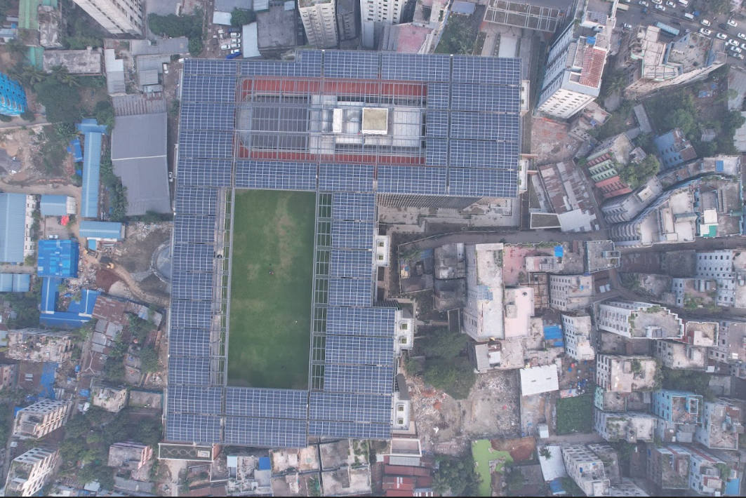
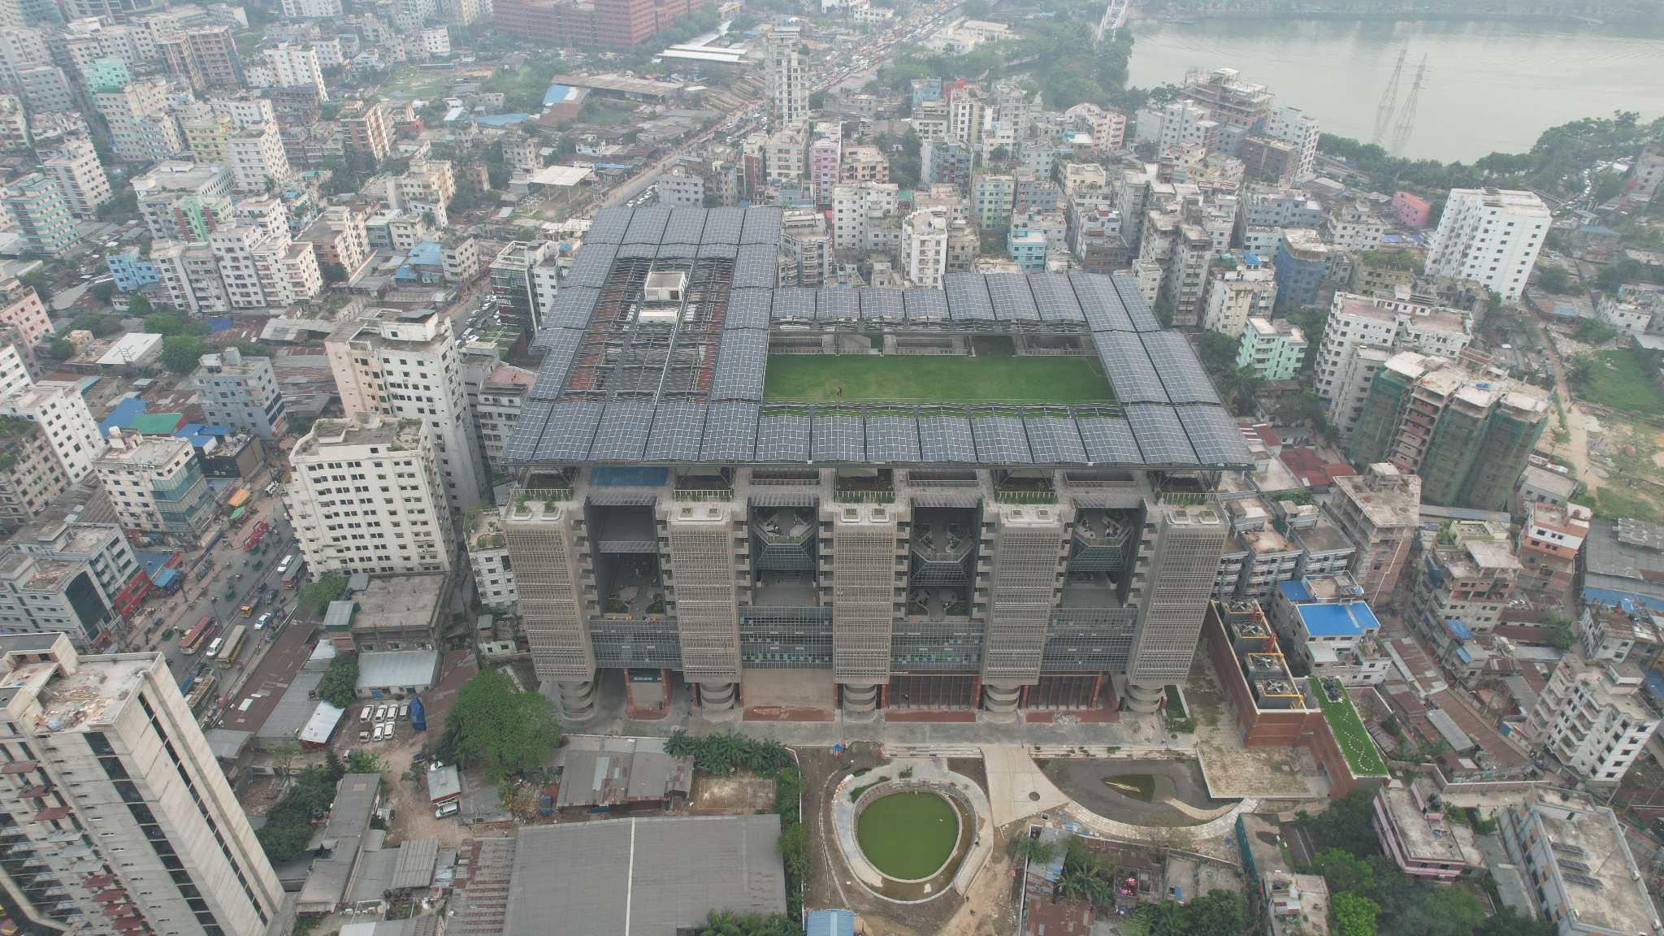
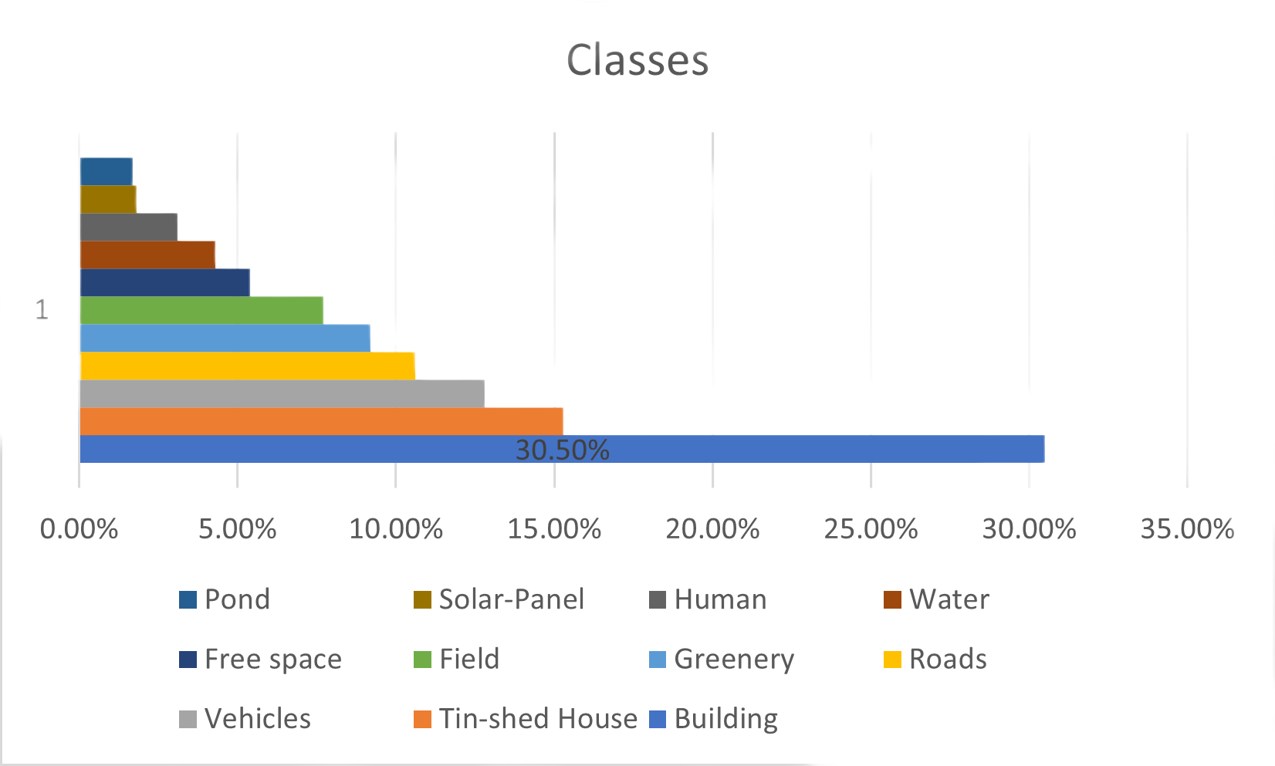
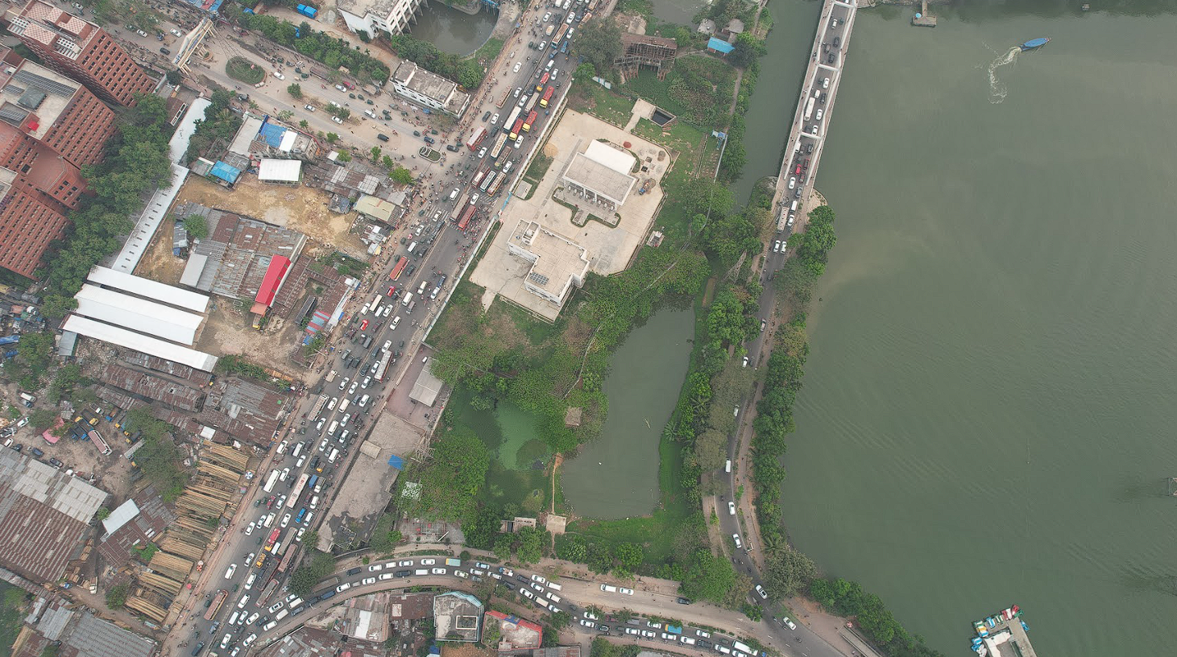
13
Input Data
We collected images for our dataset in three separate sessions, each two months apart.
Row images total 350 and 17 videos for the dataset.
From those 17 videos we extracted pictures from frame to frame
.

Slide 14
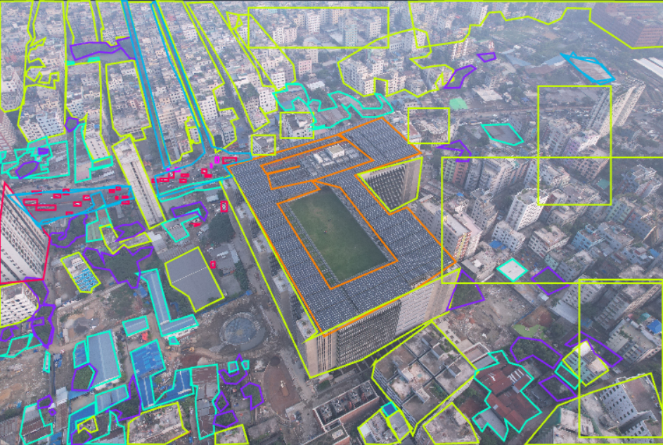
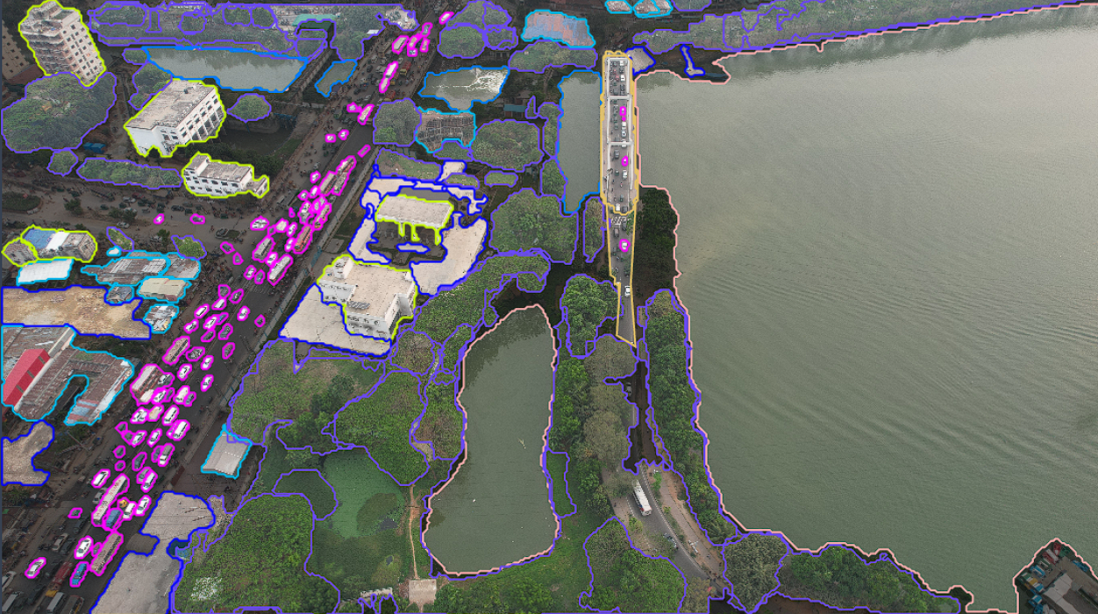
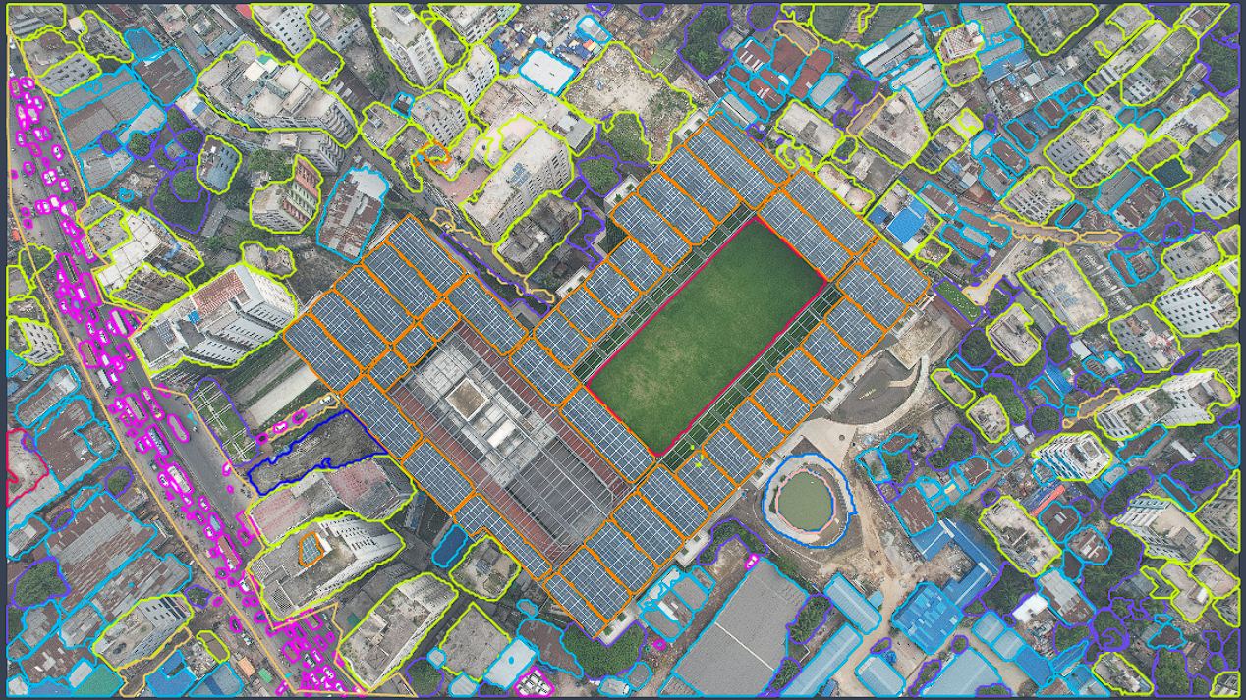
14
Annotated Images
.
Used Roboflow Software
Did 50,000 annotations (approx.) manually

Slide 15
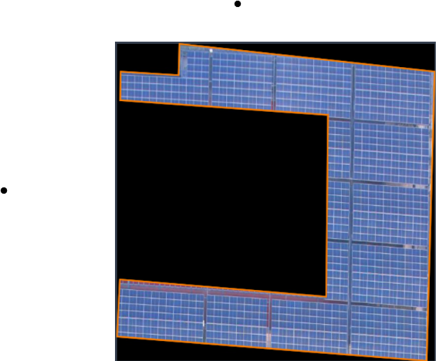
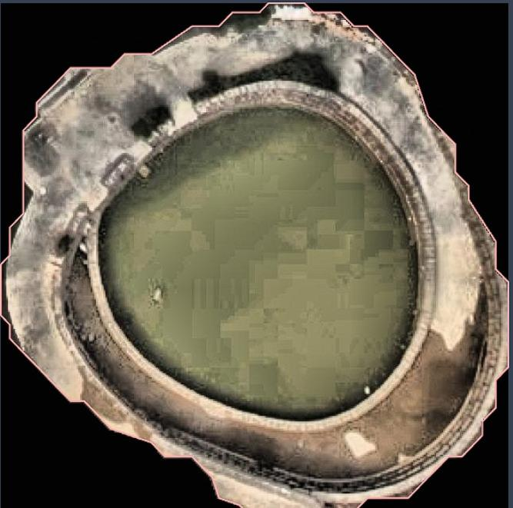
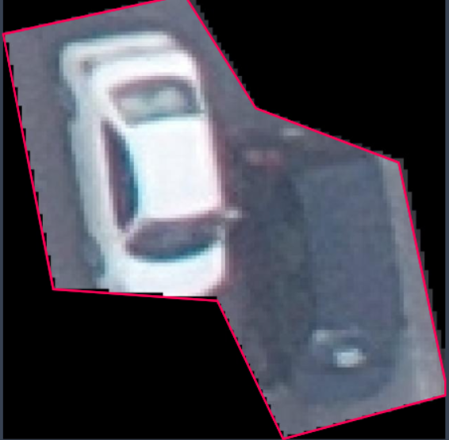
15
Data Preprocessing
Object Isolation
Isolated different objects according to the classes
Data Filtering
Enhances data quality: Removing null or corrupt images improves dataset signal-to-noise ratio.
Focuses analysis: By retaining only relevant information, data filtering provides a more accurate and focused analysis.
Augmentation
Increases dataset diversity: Applying augmentation techniques generates variations, enriching training examples.
Improves generalization: By introducing variations in the training samples, such as rotations, translations, flips, or color distortions, noise removal for the model learns to be more robust

Slide 16
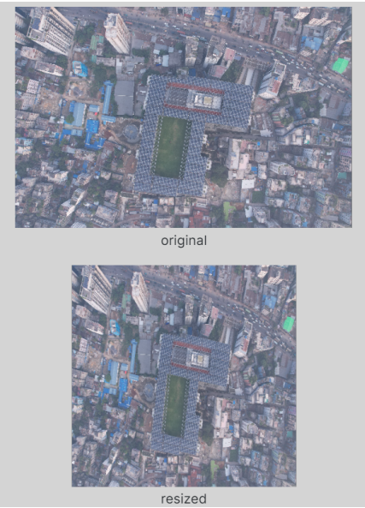
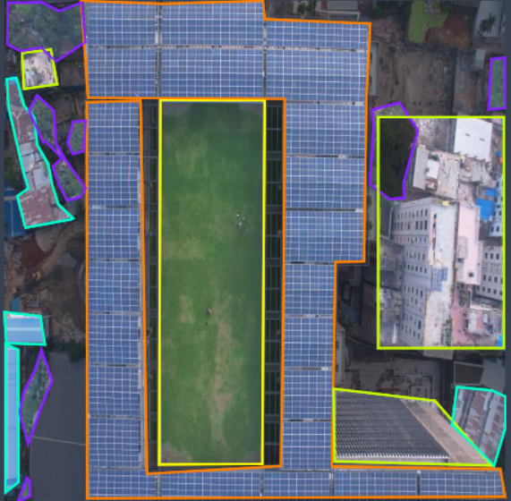
16
Data Preprocessing
Image Scaling
Standardization of image dimensions to 640 x 640 pixels.
Enhances analytical techniques by ensuring uniformity in image size.
Orientation
Technique to correct irregular orientation in photos.
Standardizes characteristics across all photos for consistency.

Slide 17
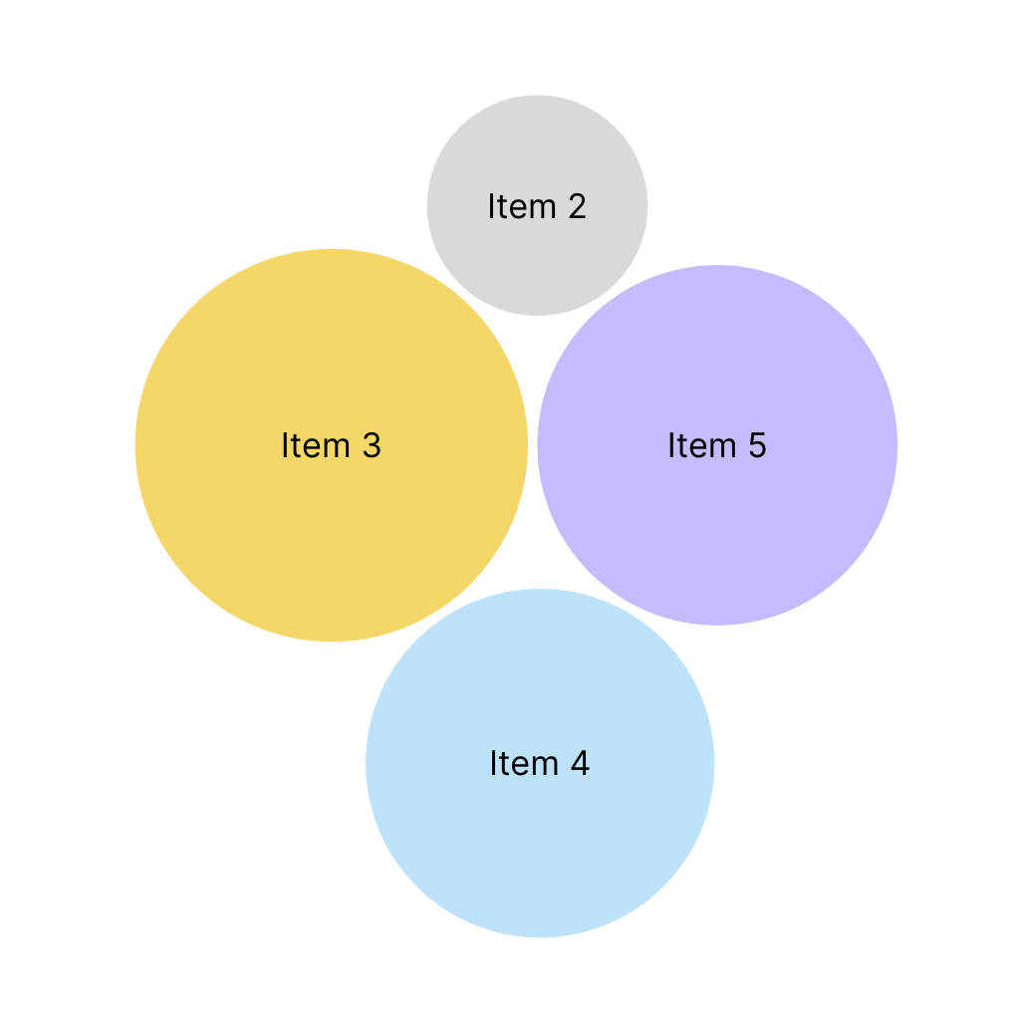




17
Custom Model
Result
We tried 4 different models to train and test our custom dataset.

Slide 18
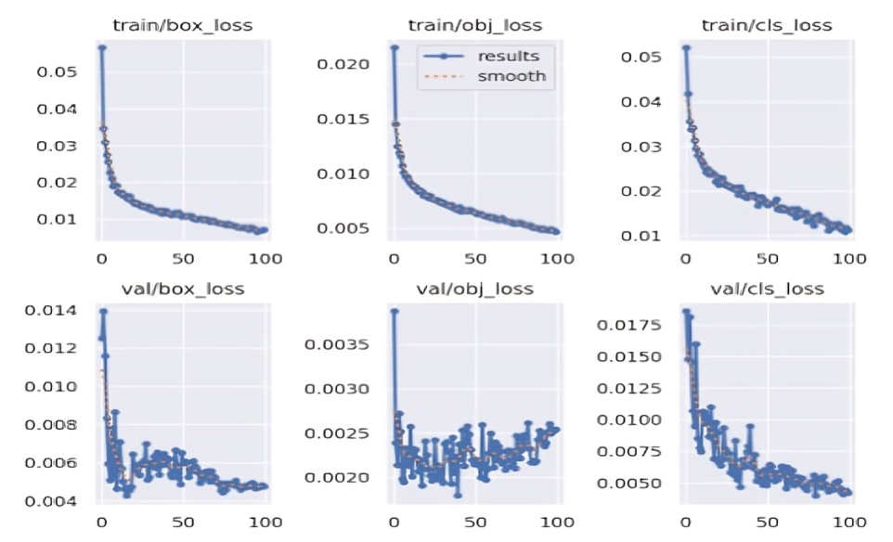
18
Result
Yolo v5

Slide 19
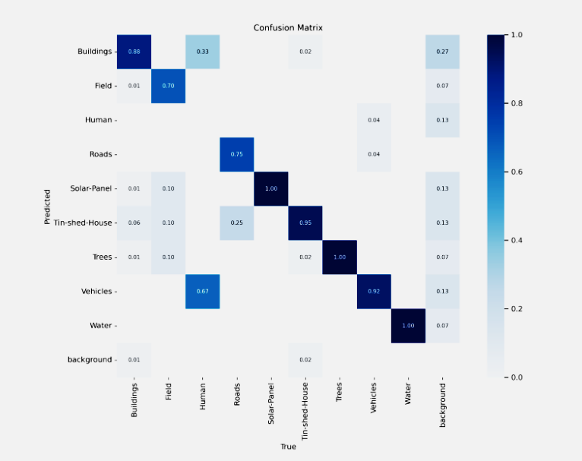
19
Result
Yolo v5

Slide 20
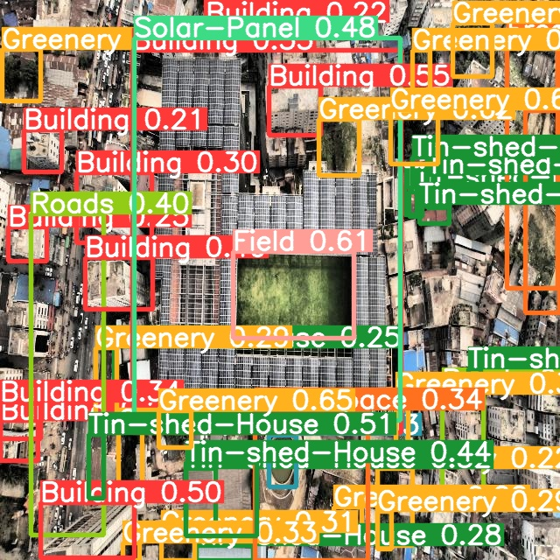
20
Result
Yolo v5
Predicted output from Yolo v5

Slide 21
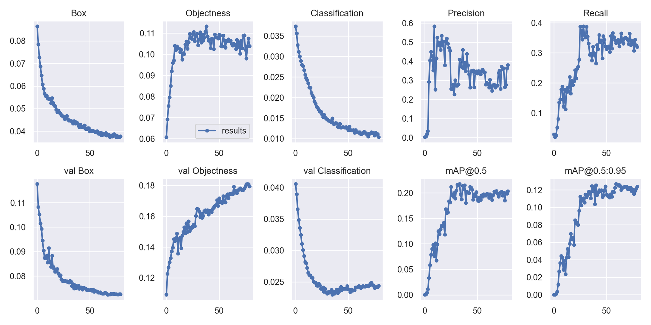
21
Result
Yolo v7

Slide 22
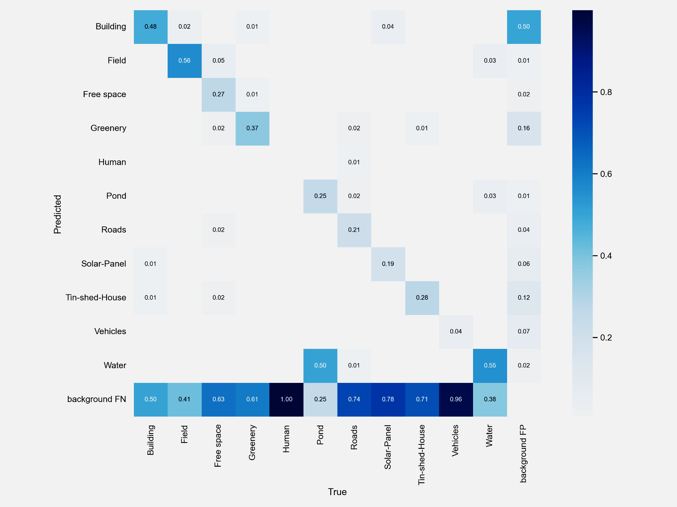
22
Result
Yolo v7

Slide 23
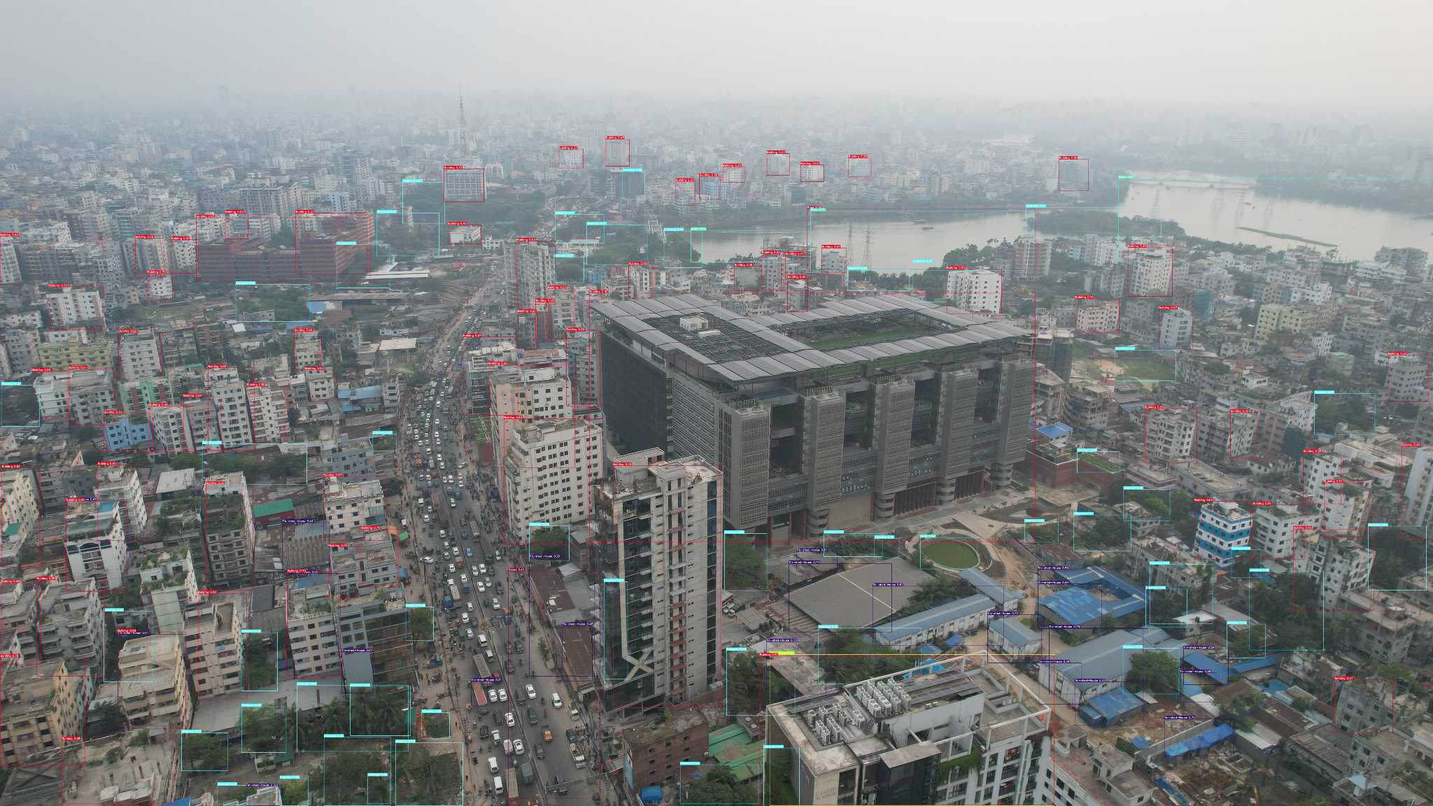
23
Result
Yolo v7
Predicted output from Yolo v7

Slide 24
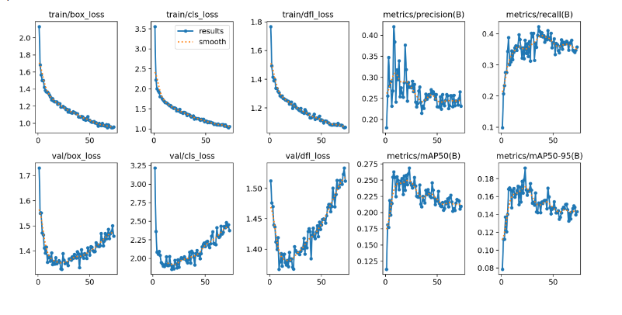
24
Result
Yolo v8

Slide 25
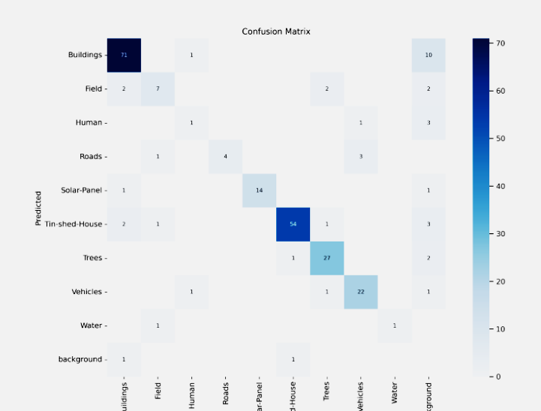
25
Result
Yolo v8

Slide 26
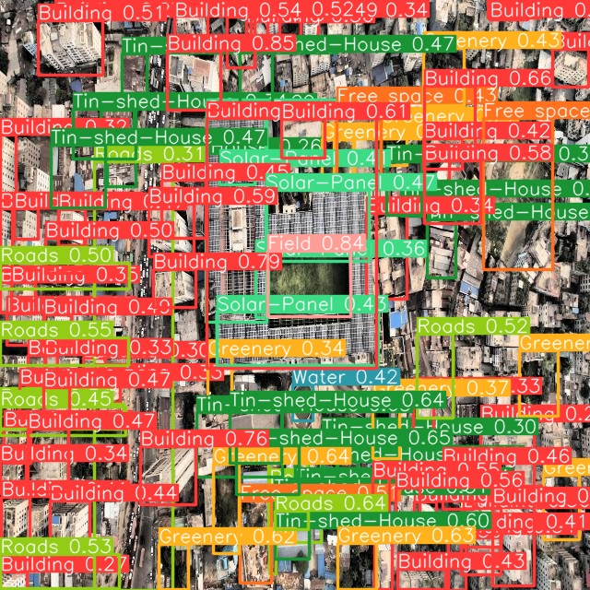
26
Result
Yolo v8
Predicted output from Yolo v8

Slide 27
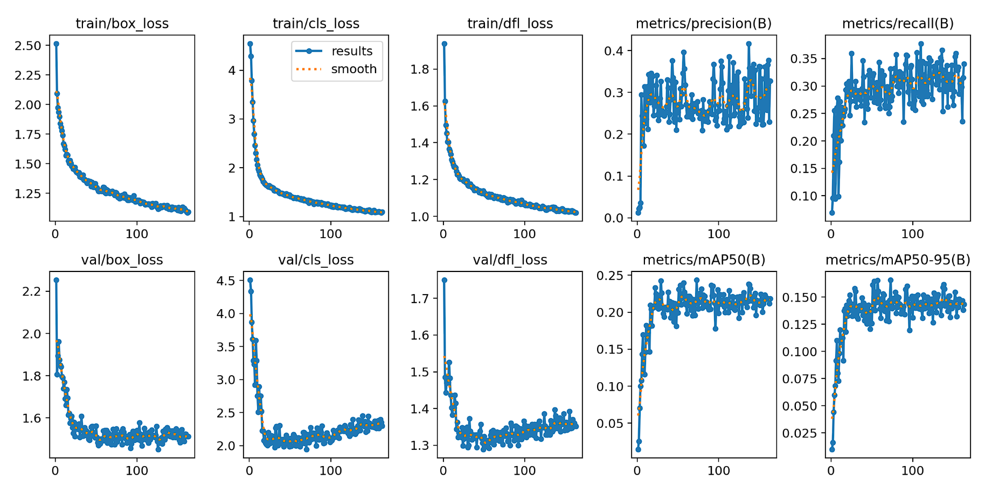
27
Result
Custom Model

Slide 28
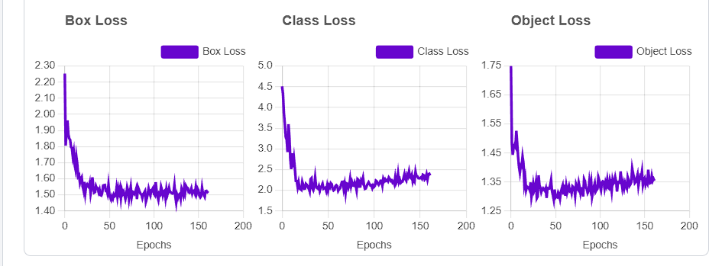
28
Result
Custom Model

Slide 29
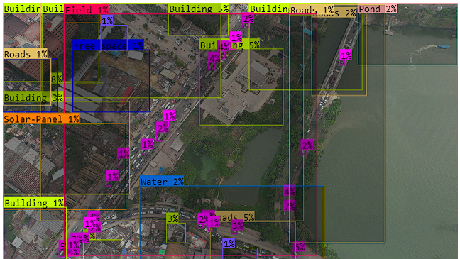
29
Result
Custom Model
Predicted output from Custom Model

Slide 30
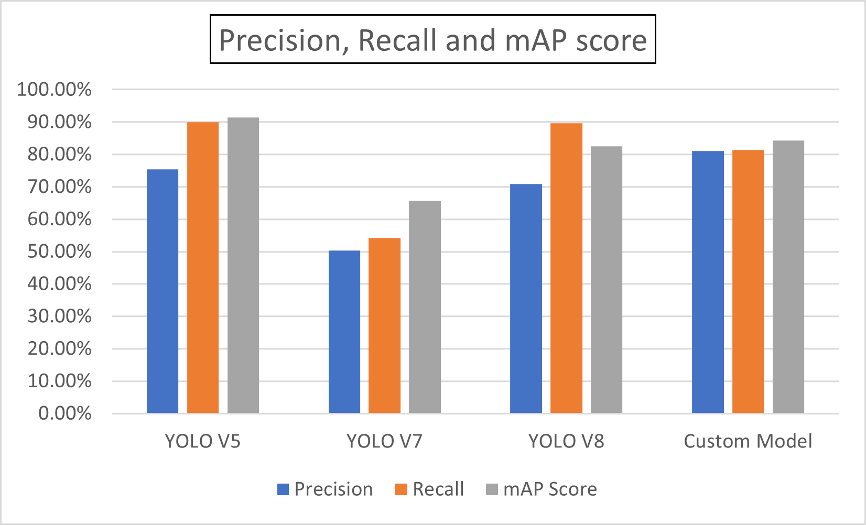
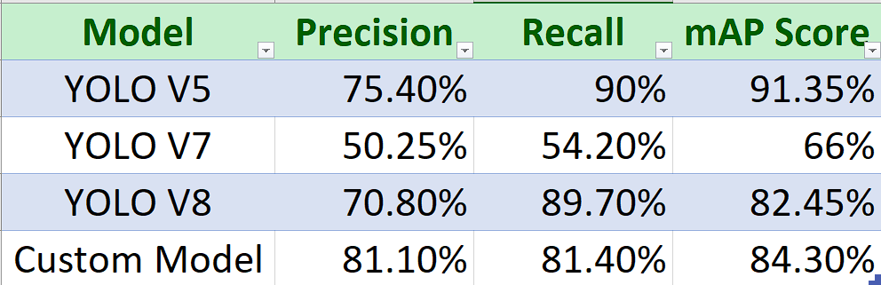
30
Analysis

Slide 31
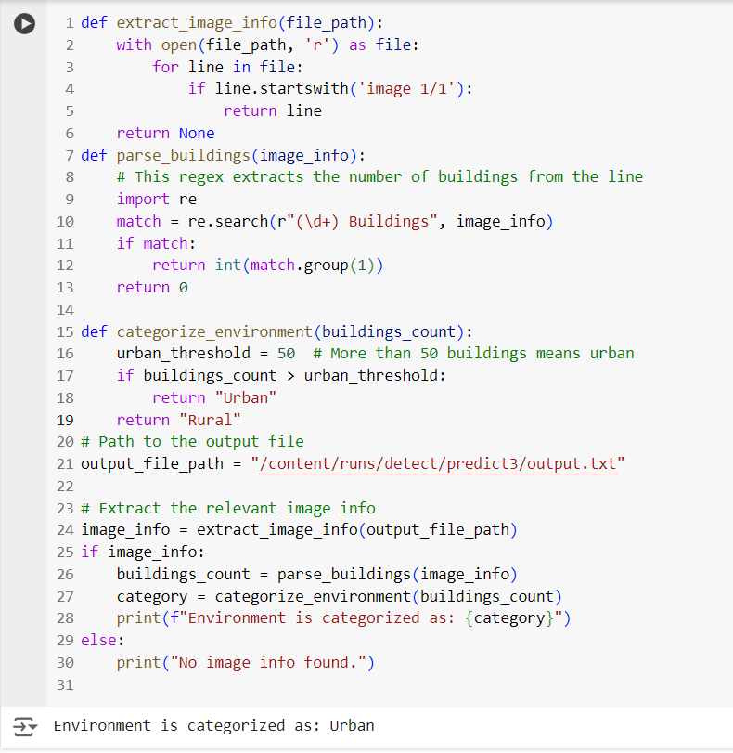
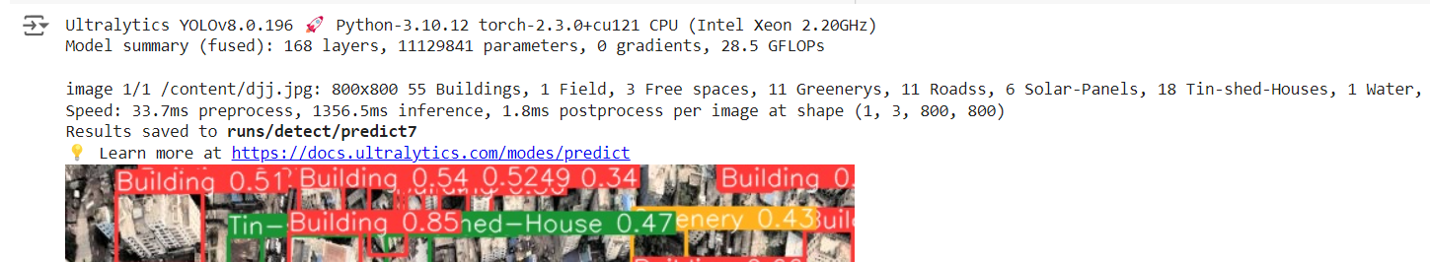
Analysis
31

Slide 32
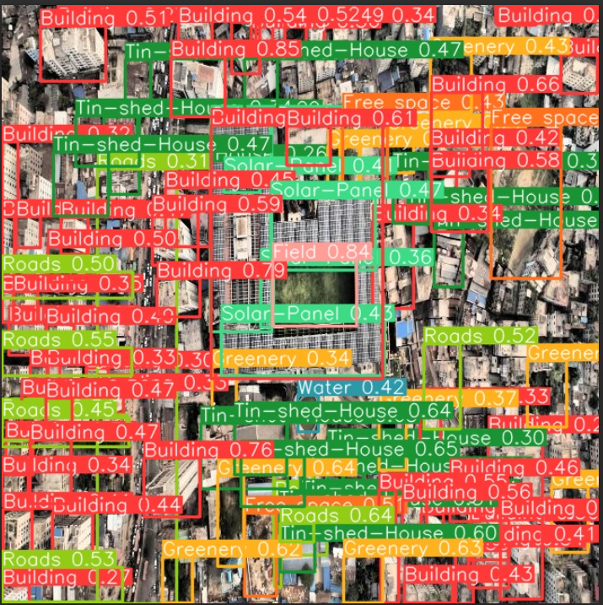
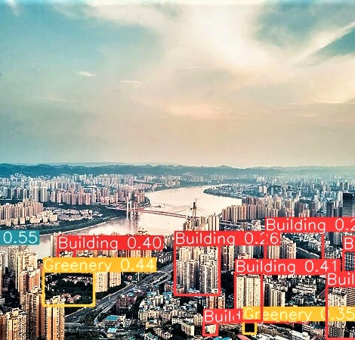
14
28
32
Comparison
13
Better Prediction of Bangladeshi Image in Our Model
Less Accurate Prediction of Foreign Image in Our Model

Slide 33
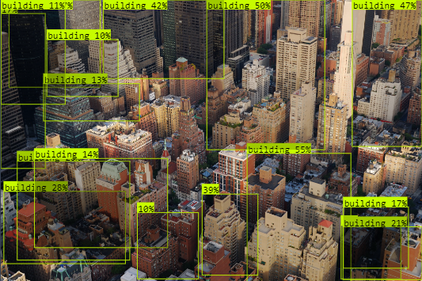
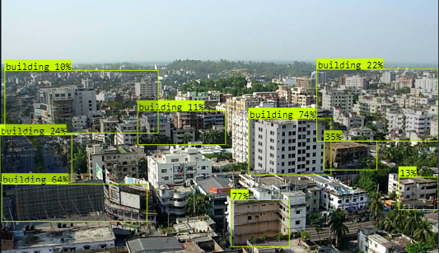
14
28
33
Comparison
13
Better Prediction of Foreign Image in Foreign Model
Less Accurate Prediction of Bangladeshi Image in Foreign Model

Slide 34
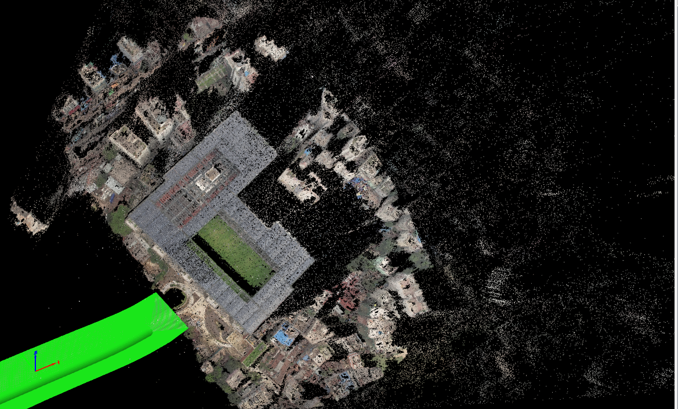
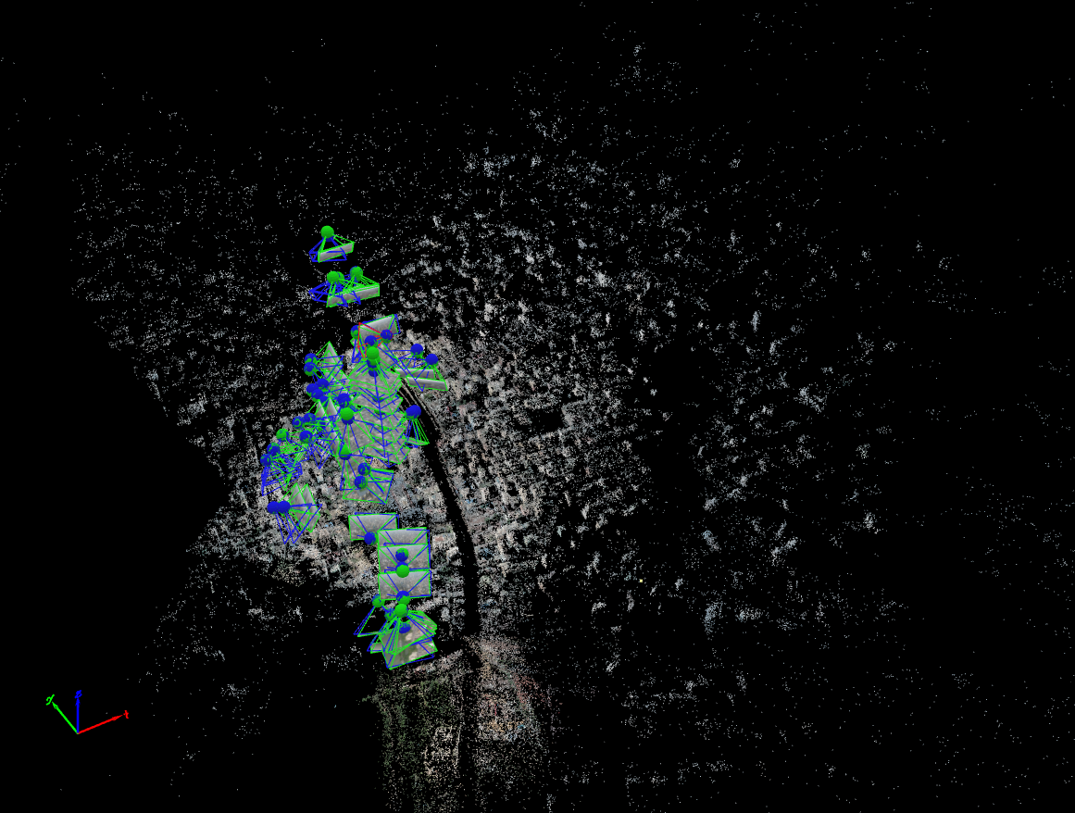
34
3D Photogrammetry Implementation
Mesh Construction
Densify Point Cloud

Slide 35
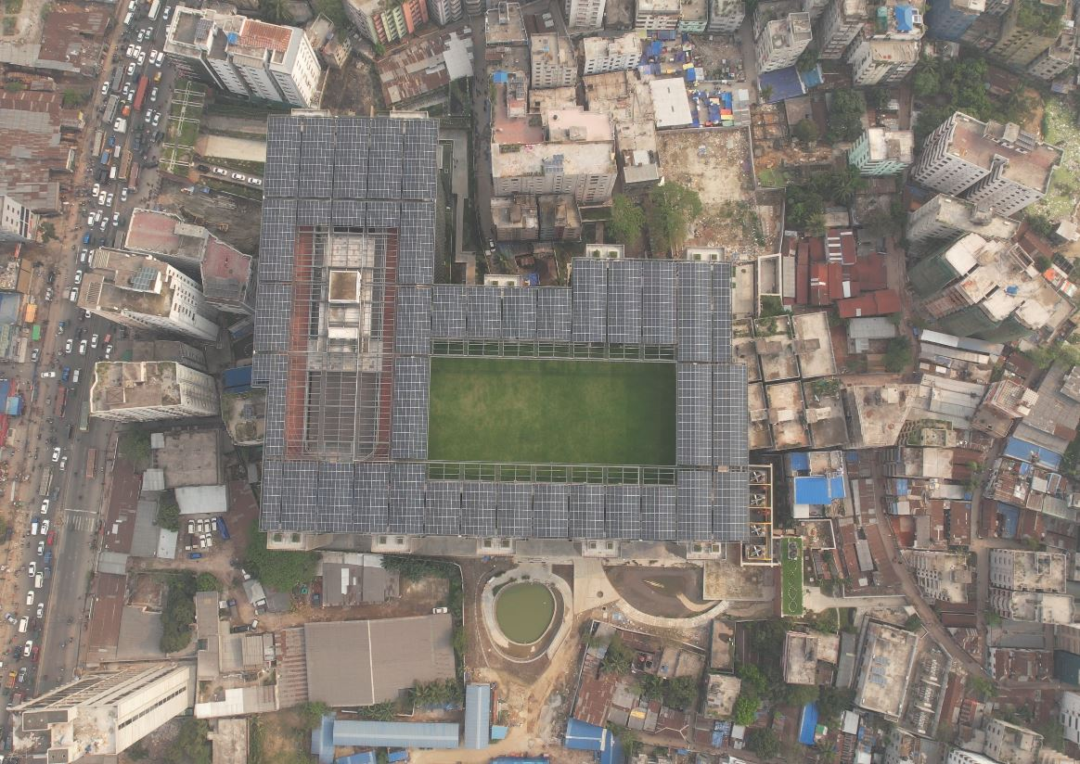
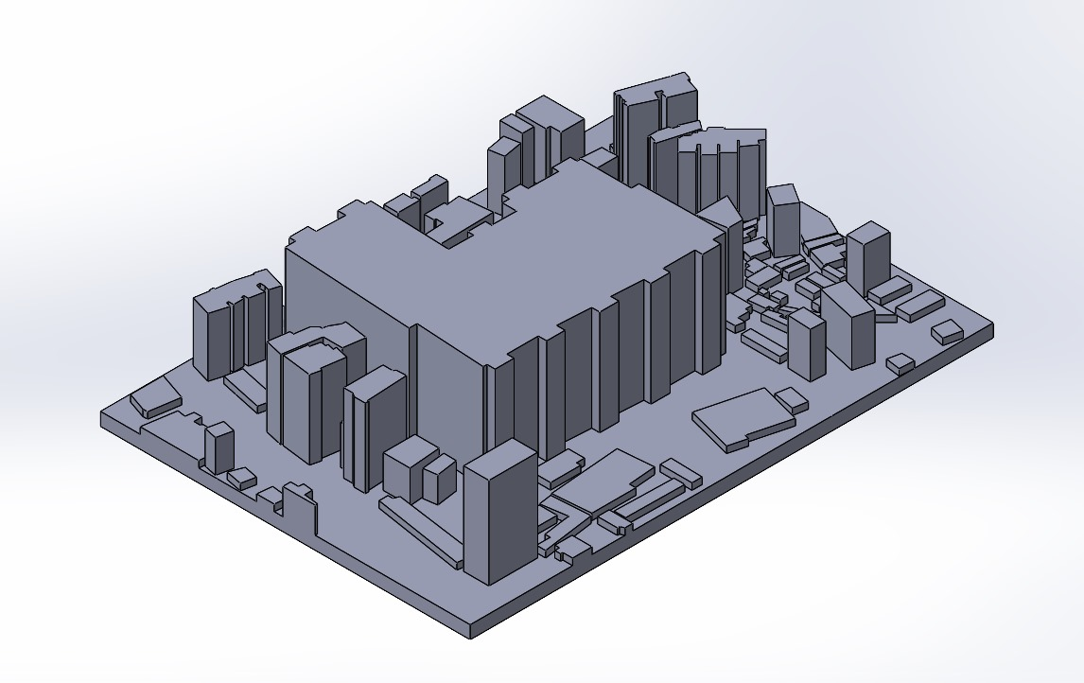
14
28
35
3D Augmentation
13
RAW Image
3D Modeling

Slide 36
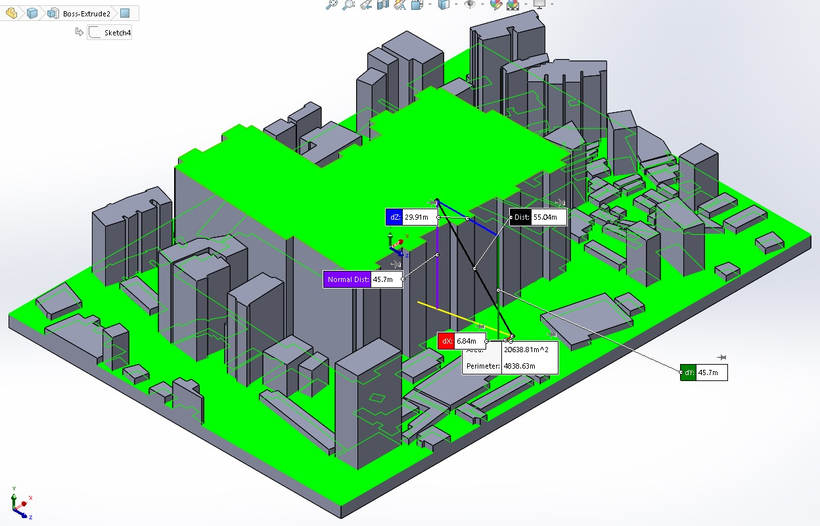
14
28
36
Height Prediction
13
Predicted Height of buildings from the ground to the top measurement.
Keeping BRAC University new campus as a reference.

Slide 37

14
28
37
13
Distance Between Buildings Prediction
Less Earthquake prone !
Long Distance

Slide 38

14
28
38
13
Distance Between Buildings Prediction
More Earthquake prone !
Short Distance

Slide 39

14
28
39
Map Integration
13
Uploading a unseen image
Pin-points the exact location using geolocation info.
Inferenced with Google Map

Slide 40




14
28
40
Future Work
13
3D Modeling:
Develop 3D models for city planning and disaster evaluation.
Disaster Management:
Detect seismic vulnerabilities and provide real-time monitoring.
Urban Planning:
Use 3D imagery for zoning and construction planning.
Web App Development:
Upload and analyze aerial images for Bangladesh-specific challenges.
3D Modeling
Disaster Management
Web App Development
Urban Planning

Slide 41


41
Prototype
Web App User Interface

Slide 42
42
References
[1] A. Singh, “Review article digital change detection techniques using remotelysensed data,” International Journal of Remote Sensing, vol. 10, pp. 989–1003, 1989. doi: 10.1080/01431168908903939. [Online]. Available: https://www.tandfonline.com/doi/abs/10.1080/01431168908903939
[2] A. Angel, M. Hickman, P. Mirchandani, and D. Chandnani, “Methods of analyzing traffic imagery collected from aerial platforms,” IEEE Transactions on Intelligent Transportation Systems, vol. 4, no. 2, pp. 99–107, 2003. doi: 10.1109/TITS.2003.821208. [Online]. Available: https://ieeexplore.ieee.org/ abstract/document/1253218
[3] P. Coppin, I. Jonckheere, K. Nackaerts, B. Muys, and E. Lambin, “Review article digital change detection methods in ecosystem monitoring: A review,” International Journal of Remote Sensing, vol. 25, pp. 1565–1596, 2004. doi: 10.1080/0143116031000101675. [Online]. Available: https://www.tandfonline. com/doi/full/10.1080/0143116031000101675
[4] D. W. Zaum, Robust building detection in aerial images, CMRT05. IAPRS, Vol. XXXVI, Part 3/W24, 2005. [Online]. Available: https://www.isprs.org/ proceedings/XXXVI/3-W24/papers/CMRT05 Mueller Zaum.pdf. [5] G. Gienko, J. G. Terry, and L. V. Tokalauvere, “Time series aerial photographs to detect spatiotemporal changes in coastal areas of fiji,” The South Pacific Journal of Natural and Applied Sciences, 2008. doi: 10.1071/sp08009. [Online]. Available: https://doi.org/10.1071/sp08009
[6] B. Sirmacek and C. Unsalan, “Building detection from aerial images using ¨ invariant color features and shadow information,” in Department of Electrical and Electronics Engineering, Yeditepe University, 2008. doi: 10.1109/iscis. 2008.4717854. [Online]. Available: https://doi.org/10.1109/iscis.2008.4717854
[7] J. Gleason, A. V. Nefian, X. Bouyssounousse, T. Fong, and G. Bebis, “Vehicle detection from aerial imagery,” in 2011 IEEE International Conference on Robotics and Automation, Shanghai, China, 2011, pp. 2065–2070. doi: 10 . 1109/ICRA.2011.5979853. [Online]. Available: https://ieeexplore.ieee.org/ abstract/document/5979853
[8] L. Bruzzone and F. Bovolo, “A novel framework for the design of changedetection systems for very-high-resolution remote sensing images,” Proceedings of the IEEE, vol. 101, no. 3, pp. 609–630, 2013. doi: 10.1109/JPROC.2013. 2247551. [Online]. Available: https://ieeexplore.ieee.org/document/6948368
[9] S. Jin, L. Yang, P. Danielson, C. Homer, J. Fry, and G. Xian, “A comprehensive change detection method for updating the national land cover database to circa 2011,” Remote Sensing of Environment, vol. 132, pp. 159–175, 2013. doi: 10.1016/j.rse.2013.01.001. [Online]. Available: https://www.sciencedirect. com/science/article/abs/pii/S0034425713000242
[10] K. Liu and G. Mattyus, “Fast multiclass vehicle detection on aerial images,” IEEE Geoscience and Remote Sensing Letters, vol. 12, no. 9, pp. 1938–1942, 2015. doi: 10.1109/LGRS.2015.2439517. [Online]. Available: https://ieeexplore. ieee.org/abstract/document/7122912

Slide 43
43
[11] F. Alidoost and H. Arefi, “A cnn-based approach for automatic building detection and recognition of roof types using a single aerial image,” Pfg – Journal of Photogrammetry, Remote Sensing and Geoinformation Science, vol. 86, no. 5- 6, pp. 235–248, 2018. doi: 10.1007/s41064-018-0060-5. [Online]. Available: https://doi.org/10.1007/s41064-018-0060-5
[12] K. L. Jong and A. S. Bosman, “Unsupervised change detection in satellite images using convolutional neural networks,” in 2019 International Joint Conference on Neural Networks (IJCNN), 2018, pp. 1–8. [Online]. Available: https: //www.semanticscholar.org/unsupervised-change-detection.
[13] K. De Jong and A. Sergeevna Bosman, “Unsupervised change detection in satellite images using convolutional neural networks,” in 2019 International Joint Conference on Neural Networks (IJCNN), IEEE, 2019, pp. 1–8. doi: 10.1109/IJCNN.2019.8852236. [Online]. Available: https://ieeexplore.ieee. org/document/5196726.
[14] D. Yadav, M. Choksi, and M. A. Zaveri, “Supervised learning based greenery region detection using unnamed aerial vehicle for smart city application,” in 2019 10th International Conference on Computing, Communication and Networking Technologies (ICCCNT), Kanpur, India, 2019, pp. 1–7. doi: 10.1109/ ICCCNT45670.2019.8944548. [Online]. Available: https://ieeexplore.ieee.org/ abstract/document/8944548
[15] M. Won, “Intelligent traffic monitoring systems for vehicle classification: A survey,” IEEE Access, pp. 1–1, 2020. doi: 10.1109/ACCESS.2020.2987634. [Online]. Available: https://www.researchgate.net/publication/340615750 Intelligent Traffic Monitoring Systems for Vehicle Classification A Survey.
[16] R. E. Huerta-Garc´ıa, F. D. Y´epez, D. F. Lozano-Garc´ıa, et al., “Mapping urban green spaces at the metropolitan level using very high resolution satellite imagery and deep learning techniques for semantic segmentation,” Remote Sensing, vol. 13, no. 11, p. 2031, 2021. doi: 10.3390/ rs13112031. [Online]. Available: https://doi.org/10.3390/rs13112031
[17] D. Xue, T. Lei, X. Jia, X. Wang, T. Chen, and A. Nandi, “Unsupervised change detection using multiscale and multiresolution gaussian-mixture-model guided by saliency enhancement,” IEEE Journal of Selected Topics in Applied Earth Observations and Remote Sensing, vol. 14, pp. 1796–1809, 2021. doi: 10.1109/JSTARS.2021.3052547. [Online]. Available: https://ieeexplore.ieee. org/document/9305230
[18] Y. Zhang, L. Fu, Y. Li, and Y. Zhang, “Hdfnet: Hierarchical dynamic fusion network for change detection in optical aerial images,” Remote Sensing, vol. 13, no. 8, p. 1440, 2021. doi: 10 . 3390 / rs13081440. [Online]. Available: https : //doi.org/10.3390/rs13081440
[19] N. Coghe, Detecting buildings in aerial and satellite images using semantic segmentation, 2022. [Online]. Available:https://sigblog.hexagon.com/detectingbuildings-in-aerial-and-satellite-images-using-semantic-segmentation
[20] M. Hu, Z. Li, J. Yu, X. Wan, H. Tan, and Z. Lin, “Efficient-lightweight yolo: Improving small object detection in yolo for aerial images,” Sensors, vol. 23, no. 14, p. 6423, 2023. doi: 10. 3390 / s23146423. [Online]. Available: https: //doi.org/10.3390/s23146423

Slide 44

Thank You!

